Slide 1
Web API

Slide 2
What is Web API?
In computer programming, an application programming interface (API) is a set of subroutine definitions, protocols, and tools for building software and applications. – Wiki
API is some kind of interface which has a set of functions that allow programmers to access specific features or data of an application, operating system or other services.

Slide 3
The Journey of RPC
RPC
CORBA
RMI
Remoting
Web Services
Restful API
Fast API
SpringBoot
WebAPI
Micro
Services

Slide 4
Web Services
TCP/IP
HTTP
XML
SOAP
UDDI
DISCO
WSDL
GET
POST
PUT
DELETE
TCP/IP
HTTP
SOAP-Based
RESTful

Slide 5
CRUD
Simulate the DQL and DML in SQL
Operation | HTTP Verb | Action
Create | POST | Create New Record
Read | GET | Read Record
Update | PUT | Update Existing Record
Delete | DELETE | Delete Existing Record

Slide 6
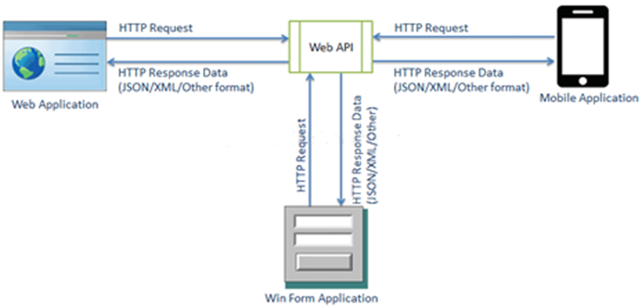
ASP.NET Web API

Slide 7
ASP.NET Web API Characteristics
ASP.NET Web API is an ideal platform for building RESTful services.
ASP.NET Web API is built on top of ASP.NET and supports ASP.NET request/response pipeline
ASP.NET Web API maps HTTP verbs to method names.
ASP.NET Web API supports different formats of response data. Built-in support for JSON, XML, BSON format.
ASP.NET Web API can be hosted in IIS, Self-hosted or other web server that supports .NET 4.0+.
ASP.NET Web API framework includes new HttpClient to communicate with Web API server. HttpClient can be used in ASP.MVC server side, Windows Form application, Console application or other apps.

Slide 8
ASP.NET Web API Versions
Web API Version | Supported .NET Framework | Coincides with | Supported in
Web API 1.0 | .NET Framework 4.0 | ASP.NET MVC 4 | VS 2010
Web API 2 | .NET Framework 4.5 | ASP.NET MVC 5 | VS 2012, 2013, 2017, 2019

Slide 9
ASP.NET Web API vs WCF
Web API | WCF
Open source and ships with .NET framework. | Ships with .NET framework
Supports only HTTP protocol. | Supports HTTP, TCP, UDP and custom transport protocol.
Maps http verbs to methods | Uses attributes based programming model.
Uses routing and controller concept similar to ASP.NET MVC. | Uses Service, Operation and Data contracts.
Does not support Reliable Messaging and transaction. | Supports Reliable Messaging and Transactions.
Web API can be configured using HttpConfiguration class but not in web.config. | Uses web.config and attributes to configure a service.
Ideal for building RESTful services. | Supports RESTful services but with limitations.

Slide 10
When to choose WCF?
Choose WCF if you use .NET Framework 3.5. Web API does not support .NET 3.5 or below.
Choose WCF if your service needs to support multiple protocols such as HTTP, TCP, Named pipe.
Choose WCF if you want to build service with WS-* standards like Reliable Messaging, Transactions, Message Security.
Choose WCF if you want to use Request-Reply, One Way, and Duplex message exchange patterns.

Slide 11
When to choose ASP.NET Web API?
Choose Web API if you are using .NET framework 4.0 or above.
Choose Web API if you want to build a service that supports only HTTP protocol.
Choose Web API to build RESTful HTTP based services.
Choose Web API if you are familiar with ASP.NET MVC.

